Slide 1
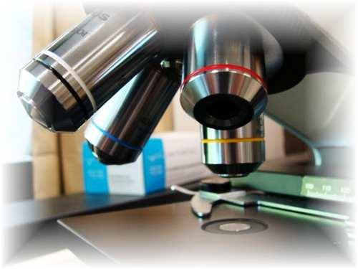
About Science Prof Online
PowerPoint Resources
Science Prof Online (SPO) is a free science education website that provides fully-developed Virtual Science Classrooms, science-related PowerPoints, articles and images. The site is designed to be a helpful resource for students, educators, and anyone interested in learning about science.
The SPO Virtual Classrooms offer many educational resources, including practice test questions, review questions, lecture PowerPoints, video tutorials, sample assignments and course syllabi. New materials are continually being developed, so check back frequently, or follow us on Facebook (Science Prof Online) or Twitter (ScienceProfSPO) for updates.
Many SPO PowerPoints are available in a variety of formats, such as fully editable PowerPoint files (.ppt), as well as uneditable versions in smaller file sizes, such as PowerPoint Shows (.pps) and Portable Document Format (.pdf), for ease of printing. The font “Jokerman” is used frequently in titles. It has a microbiology feel to it. If you do not have this font, some titles may appear odd, oversized and off-center. Find free downloads of Jokerman by Googling “download jokerman font microsoft”.
Images used on this resource, and on the SPO website are, wherever possible, credited and linked to their source. Any words underlined and appearing in blue are links that can be clicked on for more information. PPT files must be viewed in slide show mode to use the hyperlinks directly.
Several helpful links to fun and interactive learning tools are included throughout the PPT and on the Smart Links slide, near the end of each presentation. You must be in slide show mode to utilize hyperlinks and animations.
This digital resource is licensed under Creative Commons Attribution-ShareAlike 3.0:
http://creativecommons.org/licenses/by-sa/3.0/
Alicia Cepaitis, MS
Chief Creative Nerd
Science Prof Online
Online Education Resources, LLC
alicia@scienceprofonline.com
Tami Port, MS
Creator of Science Prof Online
Chief Executive Nerd
Science Prof Online
Online Education Resources, LLC
info@scienceprofonline.com
From the Virtual Microbiology Classroom on ScienceProfOnline.com
Image: Compound microscope objectives, T. Port
Notes:
Welcome to Science Prof Online PowerPoint Resources!
This PowerPoint Presentation comes from the Virtual Cell Biology Classroom of Science Prof Online, and, as such, is licensed under Creative Commons Attribution-ShareAlike 3.0.; meaning you can download, share and alter any of this presentation, but you can’t sell it or repackage and sell any part of it. Please credit Science Prof Online as the source of this presentation. Please abide by credited image copyrights. Thank you for using this resource.

Slide 2
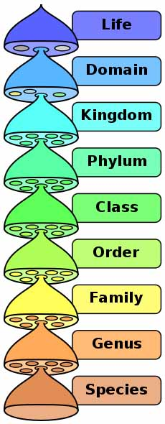
Biological Classification
The Basics
VIDEO:
Taxonomy: Life’s Filing System
from
Crash Course Biology
Image: Biological classification diagram, Peter Halasz
From ScienceProfOnline.com, free science education website.

Slide 3
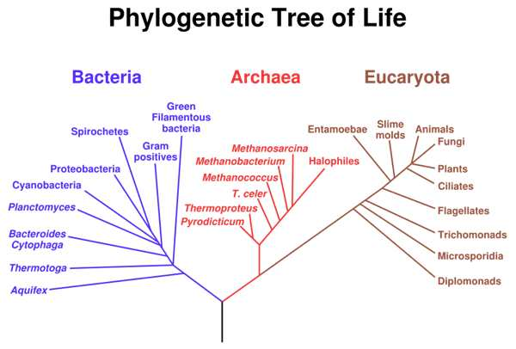
Classifying Living Things
Biological classification provides meaningful groupings of organisms based on evolutionary relationships.
To learn which organisms are most closely related, evidence is gathered from:
  Fossil record
  Comparative homologies
  Similarity of anatomy / physiology due to shared ancestry
  Comparative sequencing of genetic material (DNA & RNA) among organisms
  Q: Which of these three methods do you think is most reliable in helping us understand the “relatedness” of living things?
Eubacteria
Archaea
Eukaryota
From ScienceProfOnline.com, free science education website.
Image: Phylogenetic Tree, Eric Gaba, NASA Astrobiology institute.

Slide 4
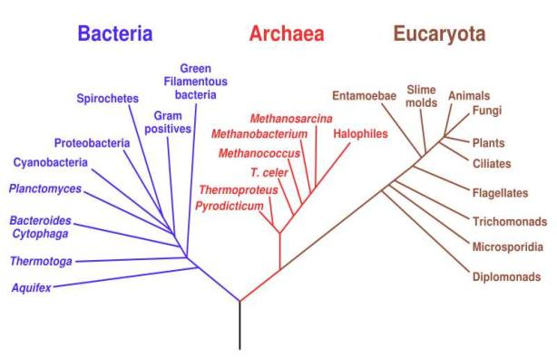
Classifying Living Things
Three Domains
Eubacteria
- True bacteria
- Prokaryotes
Exs. Streptococcus pneumoniae
Escherichia coli
Archaea
- Were thought to be same as Bacteria until recently.
- Prokaryotes
Ex. Extremophiles
Eukaryota
- All eukayotic organisms.
  Fall into 4 Kingdoms:
  Protista – Ex. algae
  Fungi – Ex. mushroom
  Plantae – Ex. Maple tree
  Animalia – Ex. you
Prokaryotes
Eukaryotes
Eubacteria
Archaea
Eukaryota
From ScienceProfOnline.com, free science education website.
Image: Phylogenetic Tree, Eric Gaba, NASA Astrobiology institute.

Slide 5
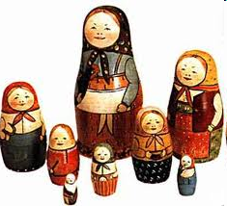
The hierarchy of biological classification has eight major taxonomic ranks which encompass all known life.
How about a trick to help us remember them?
And a little “Classification Rap” to help as well?
Classifying Living Things
Word to your Mat’!
Image: Biological classification diagram, Peter Halasz
From ScienceProfOnline.com, free science education website.
Notes:
Lazy, drunk King Philip came over for green soup.

Slide 6
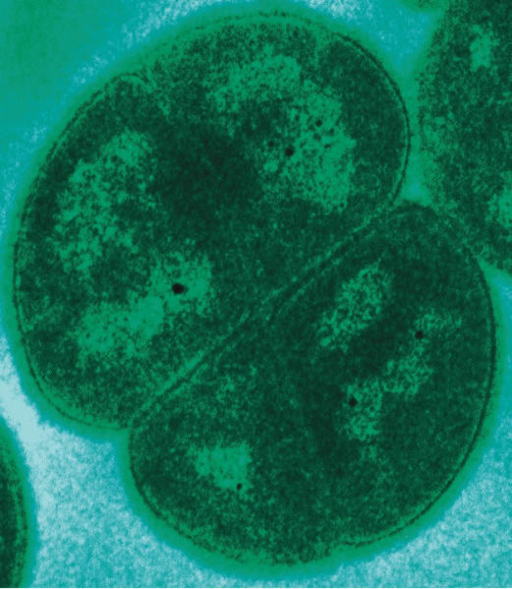
Domain: Archaea
Prokaryotic
Lack peptidoglycan
Binary fission
Many live in extreme environments.
Not known to cause disease in humans or animals.
Had been considered bacteria until examination of their unique rRNA sequences.
Include:
  Methanogens
  Extreme halophiles
  Extreme thermophiles
Image Archaea,:Deinococcus radiodurans, Michael Daly
From ScienceProfOnline.com, free science education website.

Slide 7
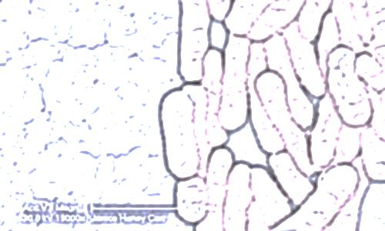
Domain: Eubacteria
Prokaryotes
Unicellular microorganisms found in every habitat on Earth.
Peptidoglycan cell walls
Binary fission
There are all varieties… pathogen, opportunist, harmless & beneficial.
In this class, we will be meeting just g a few representative prokaryotes.
From the Virtual Microbiology Classroom on ScienceProfOnline.com
Image: Salmonella, Public Health Image Library,PHIL #10973

Slide 8
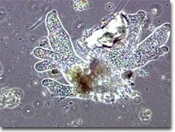
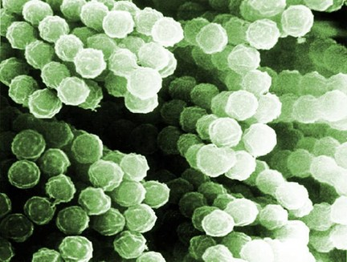
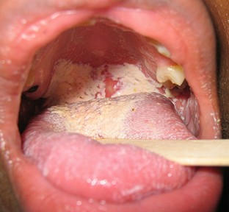
Domain: Eukaryota
Five major groups that interest microbiologists:
    Protozoans
  (some can cause infectious disease)
    Fungi
  (some can cause infectious disease)
    Helminths
  (parasitic worms that can cause infectious disease)
    Algae
  (DO NOT cause infectious disease in humans)
    Slime & Water Molds
  (DO NOT cause infectious disease in humans)
Includes both human pathogens and organisms vital for human life.
Images: Aspergillus fumigatus spores, Janice Carr, PHIL #9998; Oral candidiasis, D. Rosenbach, WikiPD
From ScienceProfOnline.com, free science education website.

Slide 9
Q: What was that clue to help us remember the hierarchy of biological classification?
Image: Biological classification diagram, Peter Halasz
From ScienceProfOnline.com, free science education website.

Slide 10
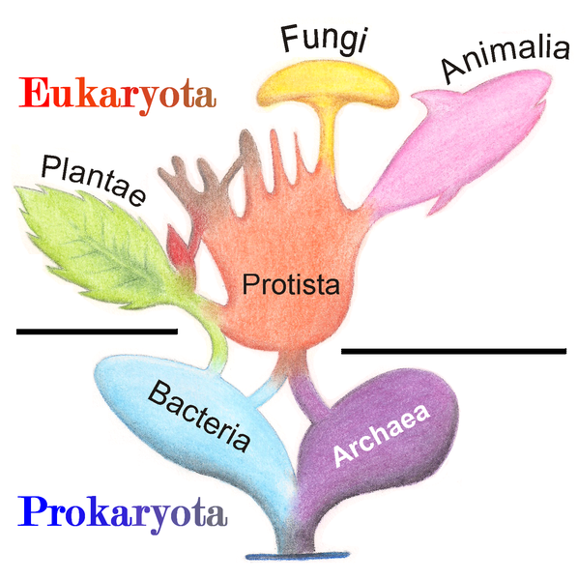
Classification of Organisms by Kingdom
Eukaryotes
Prokaryotes
Monera
From the Virtual Biology Classroom on ScienceProfOnline.com
Image: Phylogenetic Tree, Wiki

Slide 11
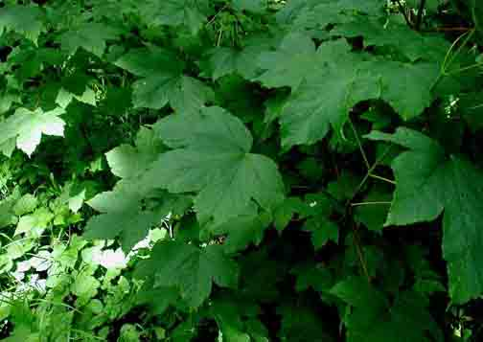
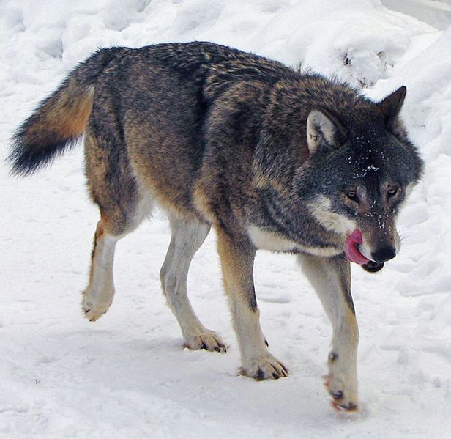
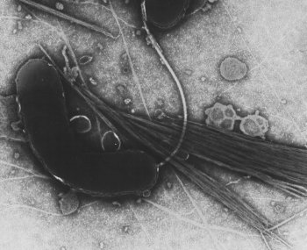
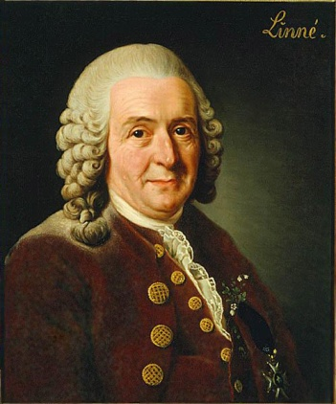
Classifying Living Things: A Little Name Calling
Binomial nomenclature: A system of naming organisms first proposed in the 1700s by Swedish scientist Carolus Linnaeus.
In binomial nomenclature, each organism is given two Latinized names:
Generic name (genus, pl. genera)
Specific name (species)
Genus names are always capitalized; species names are lower case.
Genus and species names are always italicized or underlined when written.
Q: Why does everything need to have a name? And why a universally understood name?
Acer pseudoplatanus
Canis lupus
Vibrio cholerae
Homo sapiens
Image: Sycamore Maple, Jojan; Gray Wolf, Daniel Mott; Cholera bacteria, Dartmouth Electron Microscope Facility; Carolus Linnaeus 1707 - 1778, Alexander Roslin
From ScienceProfOnline.com, free science education website.

Slide 12
REVIEW!
Video lesson on
Binomial Nomenclature
Q: What are the three rules for writing a scientific name?
Canis lupus
From the Virtual Microbiology Classroom on ScienceProfOnline.com
Image: Gray Wolf, Daniel Mott

Slide 13
Dichotomous Key
Intense pink
From the Virtual Microbiology Classroom on ScienceProfOnline.com
Light, uneven pink

Slide 14
Confused?
Here are links to fun resources that further explain
biological classification:
Biological Classification section of the science education website Virtual Microbiology Classroom of Science Prof Online.
“I’ve Got a Name” song by Jim Croche.
Evolution of the Three Domains animated science tutorial.
Classifying Life interactive game from PBS Nova.
“Classification Rap” hilarious music video from 1989.
Bacterial Pathogen Pronunciation Station, a webpage with links to audio files containing the pronunciation of the bacterial names, created by Neal R. Chamberlain, Ph.D.
Tree of Life Cladogram, an interactive diagram on classification.
Biological Classification: Kingdoms, video by Invictus1708.
(You must be in PPT slideshow view to click on links.)
Smart Links
From ScienceProfOnline.com, free science education website.

Slide 15

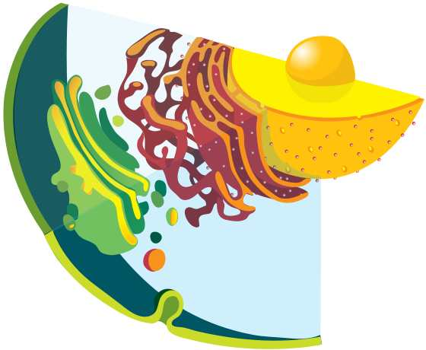
Is your brain about to explode from biology overload?
Do yourself a favor. Visit…
Science Prof Online a free science education website full of resources to help you become a total genius, including:
science articles
PowerPoints
practice test questions
review questions
study guides and learning objectives
www.ScienceProfOnline.com
Images: Endomembrane system, Mariana Ruiz, Wiki

