Slide 1
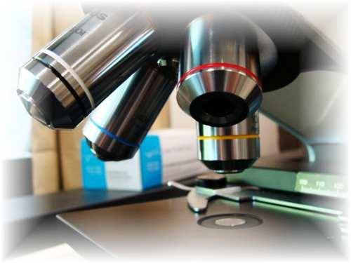
About Science Prof Online
PowerPoint Resources
Science Prof Online (SPO) is a free science education website that provides fully-developed Virtual Science Classrooms, science-related PowerPoints, articles and images. The site is designed to be a helpful resource for students, educators, and anyone interested in learning about science.
The SPO Virtual Classrooms offer many educational resources, including practice test questions, review questions, lecture PowerPoints, video tutorials, sample assignments and course syllabi. New materials are continually being developed, so check back frequently, or follow us on Facebook (Science Prof Online) or Twitter (ScienceProfSPO) for updates.
Many SPO PowerPoints are available in a variety of formats, such as fully editable PowerPoint files (.ppt), as well as uneditable versions in smaller file sizes, such as PowerPoint Shows (.pps) and Portable Document Format (.pdf), for ease of printing. The font “Jokerman” is used frequently in titles. It has a microbiology feel to it. If you do not have this font, some titles may appear odd, oversized and off-center. Find free downloads of Jokerman by Googling “download jokerman font microsoft”.
Images used on this resource, and on the SPO website are, wherever possible, credited and linked to their source. Any words underlined and appearing in blue are links that can be clicked on for more information. PPT files must be viewed in slide show mode to use the hyperlinks directly.
Several helpful links to fun and interactive learning tools are included throughout the PPT and on the Smart Links slide, near the end of each presentation. You must be in slide show mode to utilize hyperlinks and animations.
This digital resource is licensed under Creative Commons Attribution-ShareAlike 3.0:
http://creativecommons.org/licenses/by-sa/3.0/
Alicia Cepaitis, MS
Chief Creative Nerd
Science Prof Online
Online Education Resources, LLC
alicia@scienceprofonline.com
Tami Port, MS
Creator of Science Prof Online
Chief Executive Nerd
Science Prof Online
Online Education Resources, LLC
info@scienceprofonline.com
From the Virtual Microbiology Classroom on ScienceProfOnline.com
Image: Compound microscope objectives, T. Port
Notes:
Welcome to Science Prof Online PowerPoint Resources!
This PowerPoint Presentation comes from the Virtual Cell Biology Classroom of Science Prof Online, and, as such, is licensed under Creative Commons Attribution-ShareAlike 3.0.; meaning you can download, share and alter any of this presentation, but you can’t sell it or repackage and sell any part of it. Please credit Science Prof Online as the source of this presentation. Please abide by credited image copyrights. Thank you for using this resource.

Slide 2

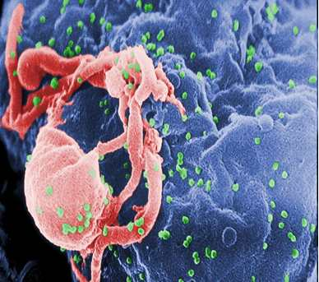
Meet the Microbes:
Viruses
Human Immunodeficiency Virus (HIV)
(Depicted in green, budding off infected white blood cell.)
Image: HIV viruses budding off of infected lymphocyte, PHIL #10000
From the Virtual Microbiology Classroom on ScienceProfOnline.com

Slide 3
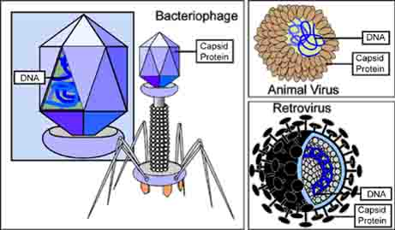
How Are Viruses Classified?
genetic material
  DNA viruses contain DNA as their genetic material.
  RNA viruses contain RNA as their genetic material.
shape
  Helical – capsomeres bonded, spiral shape
  Polyhedral – flat sides
  Spherical - round
  Complex – many different shapes
Presence or absence of a membranous envelope surrounding the capsid.
Kinds of cells they attack
  Bacteriophage
  Animal Viruses
size of virus
Q: Which of these methods of classification to you think is most useful?
Image: Types of, Viruses National Institutes of Health
From the Virtual Microbiology Classroom on ScienceProfOnline.com

Slide 4
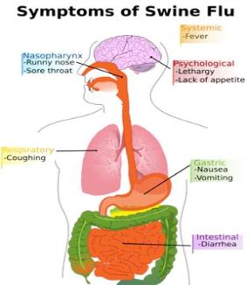

Disease, Please: Influenza Pandemic
Caused by enveloped ssRNA animal viruses
Where does the influenza virus hide?
Lots of places, including ducks, chickens, pigs whales, horses & seals.
Epidemic of an influenza virus that spreads on a worldwide scale, infecting many people.
In contrast to regular seasonal influenza epidemics, pandemics occur less frequently, with the 1918 Spanish flu the most serious pandemic in recent history.
Pandemics can cause high levels of mortality. Spanish flu was responsible for deaths of 50 – 100 million people worldwide.
~ Three influenza pandemics in each century for the last 300 years.
Most recent ones:
- Asian Flu in 1957
- Hong Kong Flu in 1968
- Swine Flu in 2009 - 2010
Occur when a new strain of influenza virus changes in a way that allows it to be transmitted to humans from animals (especially pigs, chickens and ducks).
These new strains are unaffected by immunity people may have to older human flu strains, so can spread rapidly.
Images: Swine flu symptoms, CDC; H1N1 virions, CDC
From the Virtual Microbiology Classroom on ScienceProfOnline.com

Slide 5
What is a zoonosis?
From the Virtual Microbiology Classroom on ScienceProfOnline.com

Slide 6
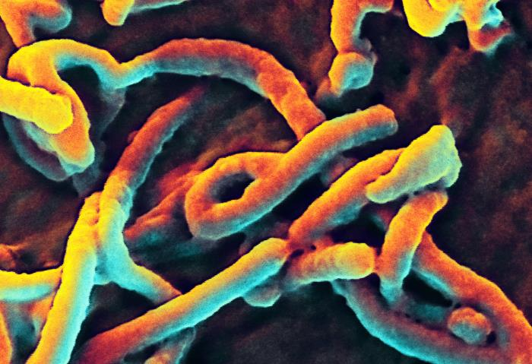
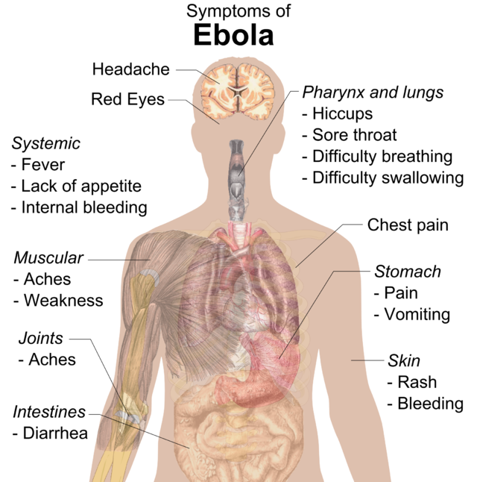
Disease Please:
Ebola Virus Disease
(a.k.a. Ebola Hemorrhagic Fever)
Caused by ssRNA animal viruses, a filovirus
Where does the Ebola virus hide?
May be present in more animals than previously thought, including chimpanzees, gorillas, fruit bats, monkeys, antelopes, porcupines, rodents, dogs, pigs and humans.
Causes severe, often fatal hemorrhagic fever in humans and other mammals.
Appeared in 1976 in 2 simultaneous African outbreaks.
2014 Ebola epidemic largest in history, more than 10,000 deaths.
Transmission
From wild animals, spreads in human population.
Direct contact with bodily fluids of infected people and animals, and contaminated surfaces.
Health-care infected when precautions not strictly practiced.
Traditional African burial ceremonies can play a role in transmission.
People remain infectious as long as body fluids contain the virus. Recovered males can transmit through semen for up to 7 weeks after recovery.
Images: Ebola symptoms, Wiki.
From the Virtual Microbiology Classroom on ScienceProfOnline.com

Slide 7
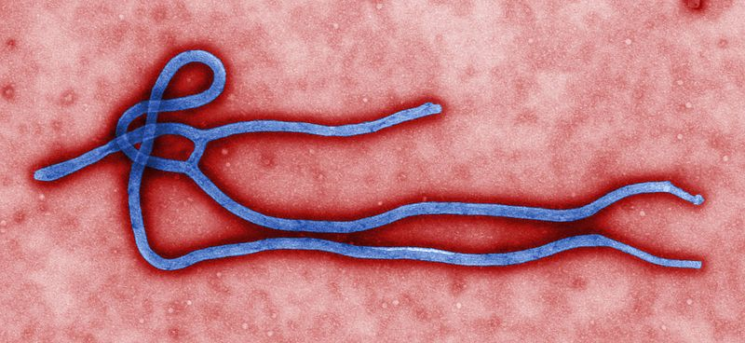
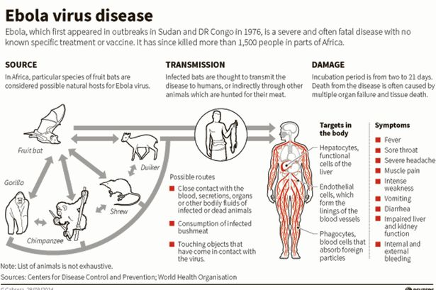
Images: Ebola Virus, PHIL #10816,CDC, EVD diagram, CDC
From the Virtual Microbiology Classroom on ScienceProfOnline.com

Slide 8
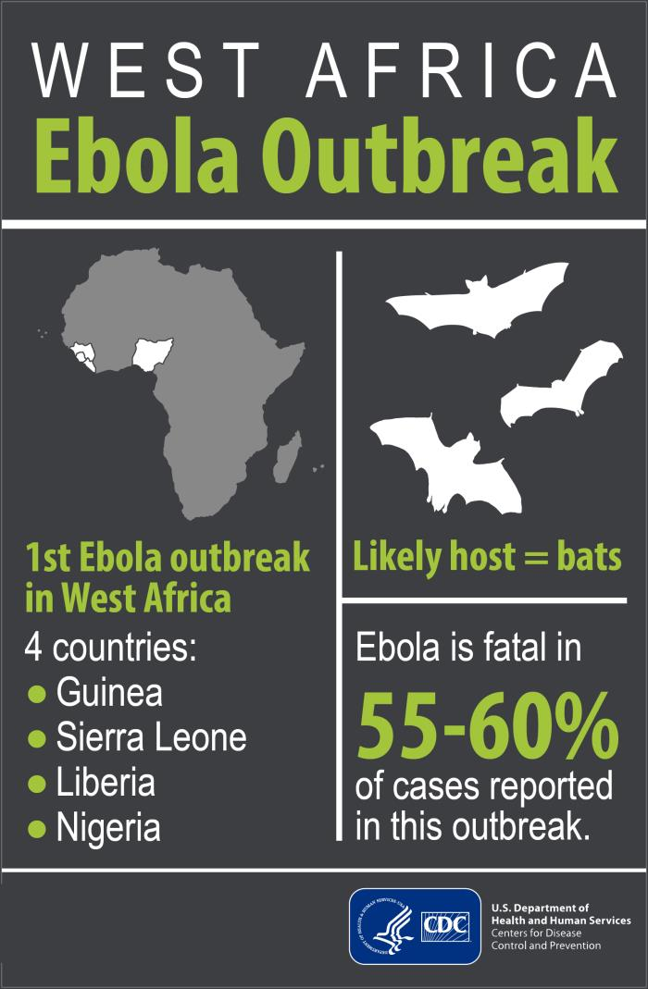
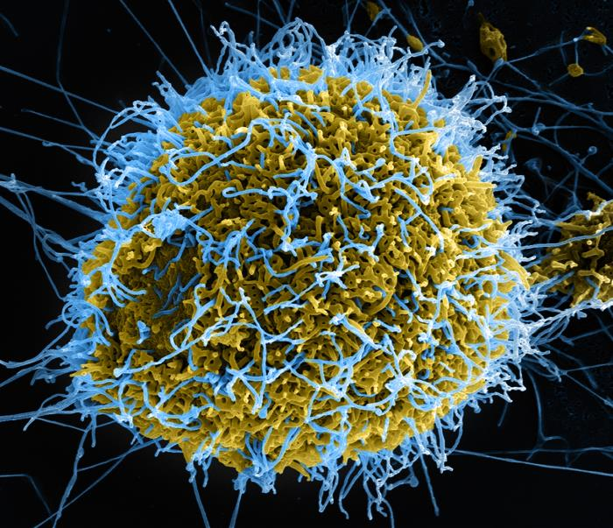
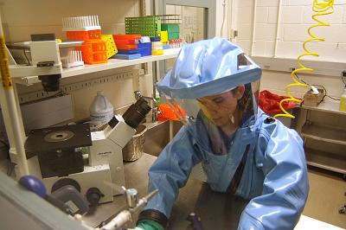

Disease Please: Ebola
Images: Vero cell budding Ebola viruses, Public Health Image Library #17768, Ebola outbreak poster, CDC; BLS-4 hazmat suit, Wiki
From the Virtual Microbiology Classroom on ScienceProfOnline.com

Slide 9
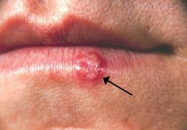

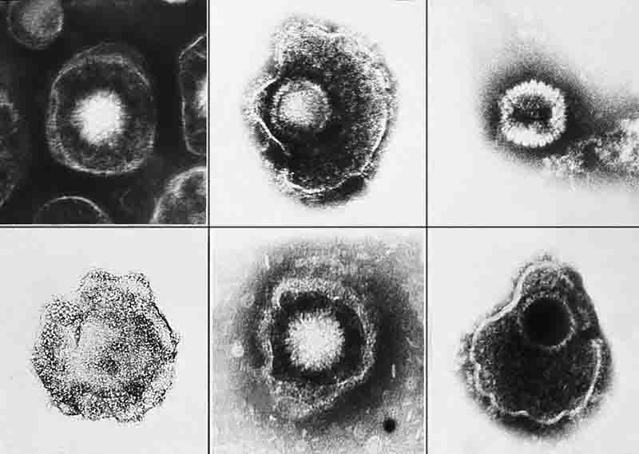
Disease, Please: Herpes
Caused by enveloped dsDNA animal viruses
• Name derived from the Greek word herpein ("to creep"), referring to the latent, recurring infections typical of this group.
Eight known herpes viruses infect humans (Human herpes viruses 1 - 8).
Often cause blistery lesions in the skin and mucous membranes.
Herpesviruses can exist in latent and actively replicating forms.
Antiviral treatments treat active infection but do not cure latent viral disease.
The following are herpesviruses:
  Herpes simplex virus 1: associated with mouth chancre sores (HHV-1 aka HSV-1).
  Herpes simplex virus 2: causes genital lesions (HHV-2 aka HSV-1).
  Varicella zoster: causes chicken pox & shingles (HHV-3 aka VZV).
  Epstein-Barr virus: causes infectious mononucleosis & is associated with Burkitt's lymphoma (HHV-4 aka EBV).
  Cytomegalovirus: can be silent or cause brain damage in newborns & blindness in AIDS patients (HHV-5 aka CMV).
  Roseola: childhood infectious rash & can cause mono-like symptoms in adults (HHV-6 and HHV-7).
  Kaposi's sarcoma: an AIDS-associated disease caused by one of seven known human cancer viruses (oncoviruses) (HHV-8 and KSHV).
“When I get a cold sore, I put Carmex on it, because Carmex is supposed to alleviate cold sores.
I don't know if it does help, but it will make them more shiny and noticeable.
It's like cold-sore-highlighter.
Maybe they could come up with an arrow that heals cold sores.”
– Mitch Hedberg
Images: HSV-1 lesion, PHIL #1573; Mitch Hedberg, Wiki; Herpesviruses, PHIL #2171.
From the Virtual Microbiology Classroom on ScienceProfOnline.com

Slide 10
Review your understanding of viruses by viewing:
Animated lesson and quiz on
Replication of
Herpes Simplex Virus
Where do herpesviruses hide?
There are more than 130 herpesviruses some are from mammals, birds, fish, reptiles, amphibians, and mollusks.
From the Virtual Microbiology Classroom on ScienceProfOnline.com
Image: Herpesviruses, PHIL #2171.

Slide 11

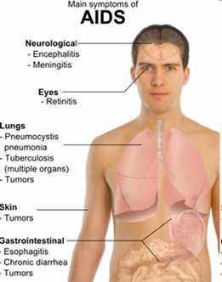
Meet the Microbe: Human Immunodeficiency Virus
Enveloped ssRNA retrovirus
Can lead to acquired immunodeficiency syndrome (AIDS).
Virus infects human immune system cells.
Origin: Sub-Saharan Africa during early 20th century.
Symptoms / Course:
  Long and variable incubation time.
  Collection of infections and tumors resulting from
  damage to host immune system.
  Although treatments exist to slow the virus progression, there is no known cure.
Transmission: Direct contact with a bodily fluid containing HIV (blood, semen, vaginal fluid, shared needles and breast milk).
Incidence: Since start of epidemic > 60 million people infected, and > 30 million have died from AIDS.
Images: Advertisement for CDC’s Act Against Aids campaign, Main symptoms of acute HIV infection Mikael Häggström
From the Virtual Microbiology Classroom on ScienceProfOnline.com

Slide 12


History of HIV & AIDS
To to learn about beginning of the AIDS pandemic read the bestselling book “And the Band Played On”.
Named in 1982, first cases of AIDS were in gay men and injection drug users with no known cause of impaired immunity.
Some AIDS associated opportunistic illnesses:
- Pneumocystis carinii pneumonia (PCP) - fungal
- Coccidioidomycosis – fungal
- Cryptosporidiosis, intestinal – protozoan
Herpesviruses
    * Cytomegalovirus disease (CMV)
* Herpes simplex (HSV-1, HSV-2)
* Kaposi's sarcoma tumors (HV8)
* Vericilla zoster (VZV)
- Histoplasmosis - fungal
- Mycobacterium avium complex - bacterial
- Tuberculosis – bacterial
- Salmonella septicemia - bacterial
- Toxoplasmosis of brain – protozoan
Everything comes from somewhere…
Where did HIV come from?
Listen to the
RADIOLAB podcast
“Patient 0” to find out.
Images: HIV viruses budding off of infected lymphocyte, PHIL #10000; HIV cycle, GFDL
Images: HIV viruses budding off of infected lymphocyte, PHIL #10000; HIV cycle, GFDL
From the Virtual Microbiology Classroom on ScienceProfOnline.com

Slide 13
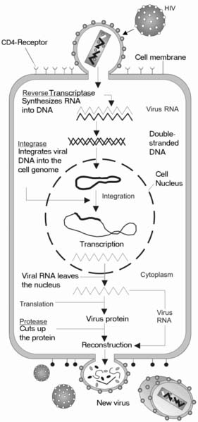
Where does the HIV virus hide?
Primates have a similar disease SIV, that ultimately gave rise to the HIV epidemic.
REVIEW!
HIV Replication animation and quiz from McGraw-Hill.
Images: HIV viruses budding off of infected lymphocyte, PHIL #10000; HIV cycle, GFDL
From the Virtual Microbiology Classroom on ScienceProfOnline.com

Slide 14
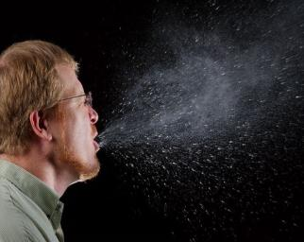
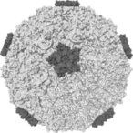
Disease, Please: Common Cold
Caused by nonenveloped ssRNA animal viruses
Can cold viruses hide?
They can’t. Only infect humans, but like most diseases, were probably of animal origin (zoonoses).
Most colds causes by Rhinoviruses (genus) and Coronavirus (a group within a genus). But more than 200 different viral types can cause colds. That is why vaccination not practical.
AKA: Nasopharyngitis, acute viral rhinopharyngitis, acute coryza (say coe-rize-ah).
TRANSMISSION:
  Spreads from infected persons through air-borne droplets, direct contact with nasal secretions or fomites.
  Infects cells of the nasal and adenoid mucous membrane.
  3. Trick infected cells into making more cold viruses, which are then transmitted as you sneeze or touch things with hands contaminated with nasal secretions.
  4. When your body catches on, inflammation occurs as body tries to rid itself of virus. It's at this point that you get fever and other cold symptoms.
SYMPTOMS: Sore throat, runny nose, nasal congestion, sneezing and cough; muscle aches, fatigue, malaise, headaches, muscle weakness, and loss of appetite. (Fever and extreme exhaustion more commonly associated with influenza).
COURSE: Symptoms usually resolve after ~ 1 week, but can last up to two.
Images: Man sneezing, PHIL #11162, Graphic of Rhinovirus, Wiki
From the Virtual Microbiology Classroom on ScienceProfOnline.com

Slide 15
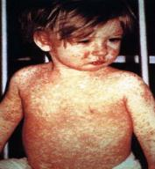
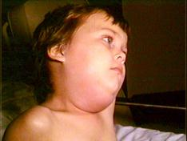
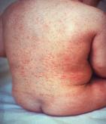
Disease, Please:
Measles, Mumps & Rubella
Where do these virus hide?
No known animal reservoir.
Caused by enveloped ssRNA viruses
Common childhood infectious diseases before widespread vaccination.
If contract as an adult, illness is more severe.
All three are highly contagious, spread by air-borne droplets.
MMR vaccine is given 2x in childhood and once in adulthood.
Measles: Classic symptoms include 3 day fever, itchy rash, and the three C’s: coughing, coryza (runny nose), and conjunctivitis (red eyes).
Mumps: Painful swelling of the salivary glands with fever. Testicular swelling and rash may also occur.
Rubella (German measles): Symptoms usually mild; similar to flu, plus a rash that starts on face and spreads to trunk and limbs. Can cause birth defects if mother contracts rubella during pregnancy.
Images: Boy with mumps, PHIL #130; Rubella rash, PHIL #712
From the Virtual Microbiology Classroom on ScienceProfOnline.com

Slide 16
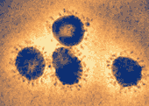
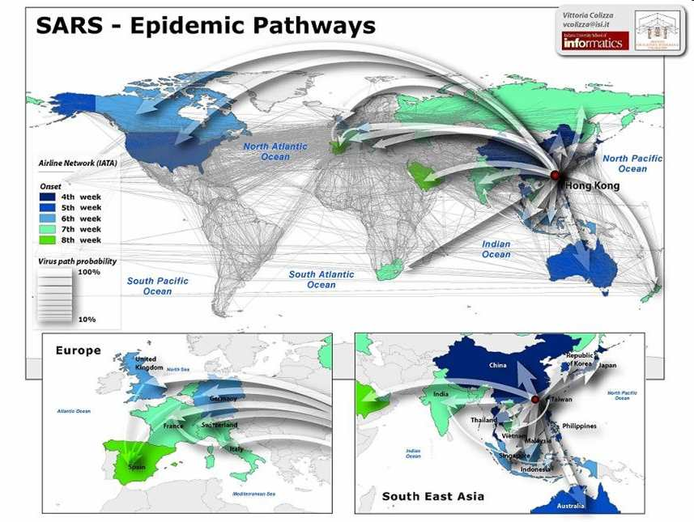
Disease, Please: SARS
Where does SARS hide?
Bats.
  Severe acute respiratory syndrome caused by the SARS coronavirus, an enveloped
  ssRNA virus.
  One near pandemic to date, with 8,096 known infected cases and 774 deaths (fatality rate of 9.6%).
  Within a matter of weeks in early 2003, SARS spread from a province of China to infect individuals in 37 countries.
  Majority of those who became sick were household contacts and health care workers.
  Scientists in the Netherlands demonstrated that the SARS virus fulfilled Koch's postulates, confirming it as the causative agent. In their experiments, macaques infected with the virus developed the same symptoms as human SARS victims.
Images: Sars coronavirus, CDC
From the Virtual Microbiology Classroom on ScienceProfOnline.com

Slide 17
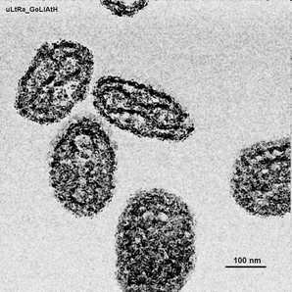
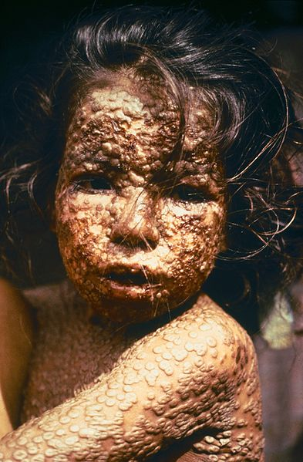
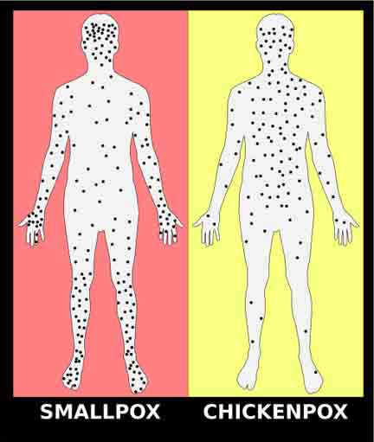
Smallpox
Caused by enveloped dsDNA animal virus.
  Caused two airborne virus variants, Variola major and Variola minor.
  Deadly disease that, in survivors, can cause disfigurement and blindness.
  Approx 500 million deaths worldwide in the 20th century.
  Eradicated in 1979 though widespread vaccination.
  Now still possible weapon of bioterrorism.
  Watch this short National
  Geographic video on Smallpox.
Can smallpox viruses hide?
They can’t. Only infect humans.
Images: Girl with smallpox, James Hicks, CDC; Electron micrograph of smallpox virus, Magnus Manske; Smallpox vs. Chickenpox
From the Virtual Microbiology Classroom on ScienceProfOnline.com

Slide 18
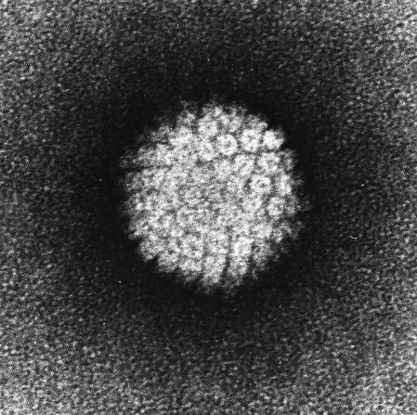
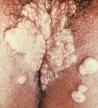
Meet the Microbe:
HPV (Human Papillomavirus)
Where does HPV virus hide?
Numerous animal species.
Nonenveloped dsDNA virus
Highly contagious sexually transmitted infection caused by several sub-types of the human papillomavirus.
Many types of HPV. Most harmless, but some cause genital warts, and a subset of those can cause cancer: of cervix, vulva and vagina in women; anus and penis in men. Can also cause cancers of head, neck and anus.
Genital warts often occur in clusters and can be very tiny or can spread into large masses in the genital area.
Two vaccines are available to prevent infection by some HPV types: Gardasil (Merck) and Cervarix (GlaxoSmithKline).
Article HPV “Vaccine Works for Boys: Study Shows First Clear Benefits”, Science News, Feb. 2011.
Centers for Disease Control
HPV vaccine
Q & A
WATCH THIS!
Dr. David Agus
explains the
risks of HPV and benefits of vaccination.
Images: Papillomavirus, Laboratory of Tumor Virus Biology
From the Virtual Microbiology Classroom on ScienceProfOnline.com

Slide 19

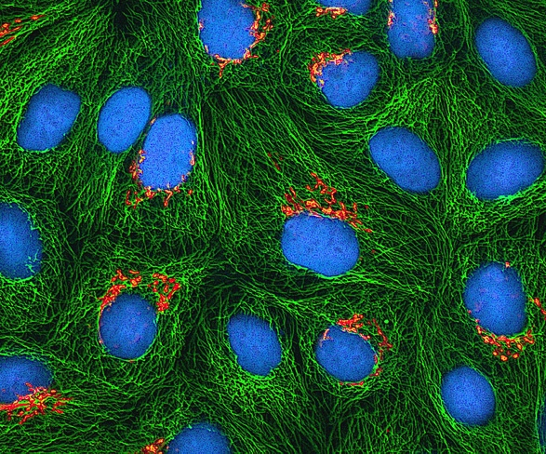
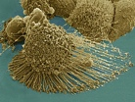
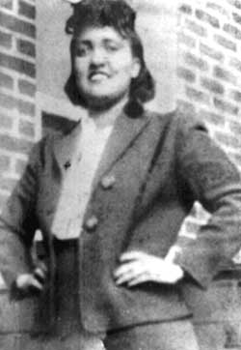
Everyday Biology
Let’s explore the amazing story of Henrietta Lacks and her immortal cells.
Q: What does the Henrietta Lacks story have to do with our lectures about cell biology and virology?
Watch a video of HeLa cells dividing in vitro.
Images: Book, “The Immortal Life of Henrietta Lacks by Rebecca Skloot; Apoptotic HeLa cell, Wiki; Fluorescence image of cultured HeLa cells, Wiki
From the Virtual Cell Biology Classroom on ScienceProfOnline.com
Notes:
HeLa cell filopodia video: https://www.youtube.com/watch?v=-tvFB-eOzJs

Slide 20
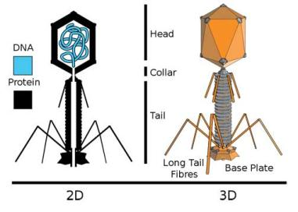
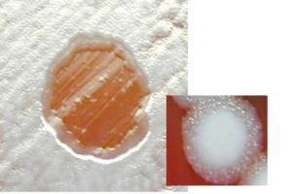
Meet the Microbe: T4 Phage
Nonenveloped dsDNA virus
(Not the true for all bacteriophages. Phages, as a
group, can have ssRN dsRNA, ssDNA, dsDNA).
A bacteriophage that infects Escherichia coli O157:H7, a cause of foodborne illness.
The "O" in the name refers to the cell wall antigen number, whereas the "H" refers to the flagella antigen. Q: What is an antigen?
Phage Therapy:
- Phages in general have been investigated as medical therapy for disabling bacteria that cause human illness, since phages are much more specific than antibiotics.
- “Human Volunteers Receiving Escherichia coli Phage T4 Orally: a Safety Test of Phage Therapy” by Anne Bruttin & Harald Brüssow, American Society for Microbiology, 2005.
REVIEW!
Steps in Replication of
T4 Phage in
E. coli
animation and quiz
from McGraw-Hill.
Images: 2D and 3D diagram of phage, Adenosine; Phage therapy used against Bacillus anthracis, US Gov
From the Virtual Microbiology Classroom on ScienceProfOnline.com

Slide 21
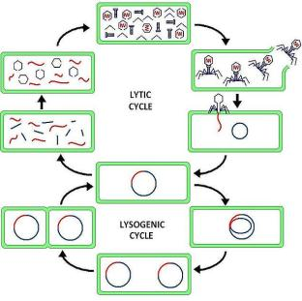
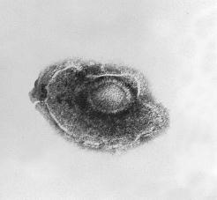
Hidden Viruses
Prophage
When bacteriophage DNA becomes integrated into DNA of host bacteria.
Q: What type of bacteriophage life cycle would a prophage be involved in?
Latency
When animal viruses remain dormant in host cells.
May be prolonged for years with no viral activity, signs, or symptoms.
Some latent viruses do not become incorporated into host chromosome.
When viral DNA is incorporated into host DNA, condition is permanent; becomes permanent physical part of host’s
Image: Bacteriophage Lysogenic Replication, Suly12 Wikimedia Commons; Varicella zoster Herpesvirus, PHIL 1878.
From the Virtual Microbiology Classroom on ScienceProfOnline.com

Slide 22
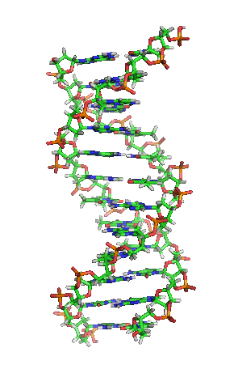
Genetic instructions of all living things are encoded in the nucleic acid DNA.
The genetic material of viruses is more varied: ssRNA, dsRNA, ssDNA or dsDNA.
Q: Only one type of genome allows a virus to become hidden. Which one?
Hidden Viruses
Image: DNA Animation, Brian0918
From the Virtual Microbiology Classroom on ScienceProfOnline.com
Notes:
dsDNA (or retrovirus that can have its RNA genome rewritten as dsDNA)

Slide 23
Modified “Live” Virus Vaccines vs “Killed” Viruses Vaccines
Modified live virus vaccines contain viruses that have been weakened (attenuated) in virulence, yet retain their antigenic properties to prompt an immune response.
MLV vaccines must replicate after inoculation to produce enough antigen to produce an immune response.
Advantages:
- One dose
- Quicker immune response
- Stronger, more durable response
- Fewer post-vaccine reactions
Killed virus vaccines contain viruses that have been treated by chemical or physical means to prevent them from replicating in the vaccinate.
Advantages:
- Safer
- No possibility for reversion
- Recommended for pregnant animals
- Stable in storage
Disadvantages :
- Possible reversion to virulence
- Possible viral shedding
Not recommended for pregnant animals - Improper handling may inactivate
Disadvantages :
Multiple doses required
Weaker immune response
Shorter duration immune response
Hypersensitivity reactions more common
From the Virtual Microbiology Classroom on ScienceProfOnline.com

Slide 24
Confused?
Here are links to fun resources that further explain Microbiology:
Viruses: Meet the Microbes Main Page on the Virtual Microbiology Classroom of Science Prof Online.
HIV Replication animation and quiz from McGraw-Hill.
Play “Sneeze”, an online game where the object is to infect as many people as possible with your coughs and sneezes.
Play Pandemic 2 a video game of strategy, where you try to become a successful pandemic microbe and infect the world. My 14-year old daughter and I recommend this one to you.
“Quarantine” a scary movie about a new infectious disease.
“Comparison of Cold & Flu Symptoms”, article, by T. Port.
“Catch My Disease” song by Ben Lee.
.
(You must be in PPT slideshow view to click on links.)
Smart Links
From the Virtual Microbiology Classroom on ScienceProfOnline.com

Slide 25
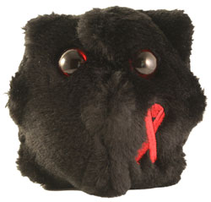
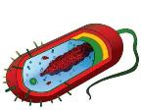
Are microbes intimidating you?
Do yourself a favor. Use the…
Virtual Microbiology Classroom (VMC) !
The VMC is full of resources to help you succeed, including:
practice test questions
review questions
study guides and learning objectives
You can access the Virtual Microbiology Classroom (VMC) onthe Science Prof Online website www.ScienceProfOnline.com
Images: HIV, Giant Microbes; Prokaryotic cell, Mariana Ruiz

